Slide 1
CSE 124 Demo: Scalable SuperProxy with Distributed File System
Tassapol Athiapinya - A50042456 Edwin Makiuchi - A07668278

Slide 2
SuperProxy
Web-based HTTP proxy
A user inputs target URL.
The proxy returns cached/non-cached contents.
Scalability depends on size of cache.

Slide 3
Solving Cache Limitations
Hardware
Huge RAM
Flash drive
External hard drive
RAID
Software
Regularly deletes data
Caches only some data

Slide 4
Solving Cache Limitations (2)
File system across multiple machines
Google File System (like we talked in class)
Our solution
Hadoop
MapReduce (for CPU scalability)
beyond our scope
Hadoop Distributed FS (for file system scalability)
What we use!
Very close to Google FS

Slide 5

HDFS Client Request
Image from http://hadoop.apache.org
Notes:
The client retrieves the file location, the number of chunks the file should be split into, and the location of the chunks from the Namenode. The, the client requests many chunks and merges them into a single file. The point of this feature is to store each file into multiple datanodes. By doing this, each datanode is not required to have a large storage to store the files.

Slide 6
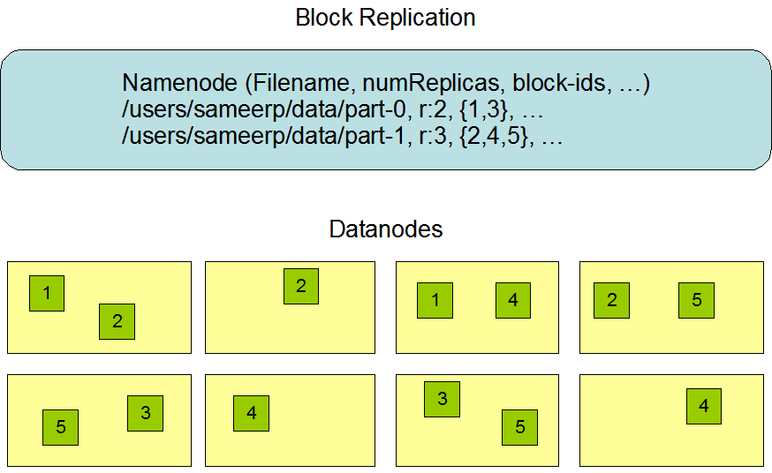
HDFS File Chunks
Image from http://hadoop.apache.org
Notes:
This is an example of HDFS chunks. Namenode contains the file name, replica and the chunks that should be stored in different Datanodes. For example, the first line contains data of file name “part-0” that is split into chunks {1,3}. For the client to retrieve data, it requests data from multiple Datanodes. The first Datanode contains chunks 1,2 and the second contains chunks 3, 5. The client retrieves data from the first and second datanode to obtain chunks 1, 3. Additionally, this feature implements backup Datanodes. If the first Datanode crashes, the client can still obtain chunk 1 from the 5th datanode. Unfortunately, in our project we had this feature implemented but due to the lack of resources we were forced to abandon the backup feature.

Slide 7
Our SuperProxy
Tomcat
HTTP Servlet
URL rewriting
Rewrite html links and image links to request data from our server
From:
http://cseweb.ucsd.edu/classes/fa10/cse124/ucsd_logo.gif
To:
http://216.24.193.224:8080/cse124demo/CheckCache?url=http://cseweb.ucsd.edu/classes/fa10/cse124/ucsd_logo.gif

Slide 8
Our SuperProxy Workflow (non-cached)
Client
inputs a URL.
2) Parallel download
Client
SuperProxy Web
Target website
5) Return data to the client
3) Save URL string and last-updated time in memory
HDFS
4) Save contents in HDFS

Slide 9
Our SuperProxy Workflow (cached data is latest)
2) URL String is found in cache.
3) Check if contents are newer than our cached data
Result: No
Client
inputs a URL.
Client
SuperProxy Web
Target website
5) Return data to the client
HDFS
4) Load contents from HDFS

Slide 10
Our SuperProxy Workflow (cached data is old)
3) Check if contents are newer than our cached data
Result: Yes
2) URL String is found in cache.
Client
inputs a URL.
Client
SuperProxy Web
Target website
4) Request new data
7) Return data to the client
5) Update URL string and last-updated time in memory
HDFS
6) Update contents in HDFS

Slide 11
Demo
Live demo at
http://216.24.193.224:8080/cse124demo/

